Slide 1
Day 5
Behold Bootstrap!
Notes:
1

Slide 2
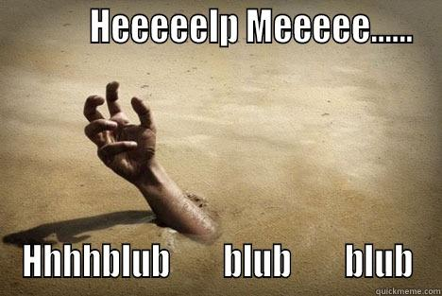

Slide 3


Slide 4


Slide 5


Slide 6
Today’s Class
Notes:
6

Slide 7
Objectives
Students will use Twitter Bootstrap to create layouts
Students will learn to use media queries for mobile responsive websites
Students will learn to use the viewport tag to make sure all devices are displaying web pages optimally

Slide 8
Recap Bootstrap
Notes:
8

Slide 9
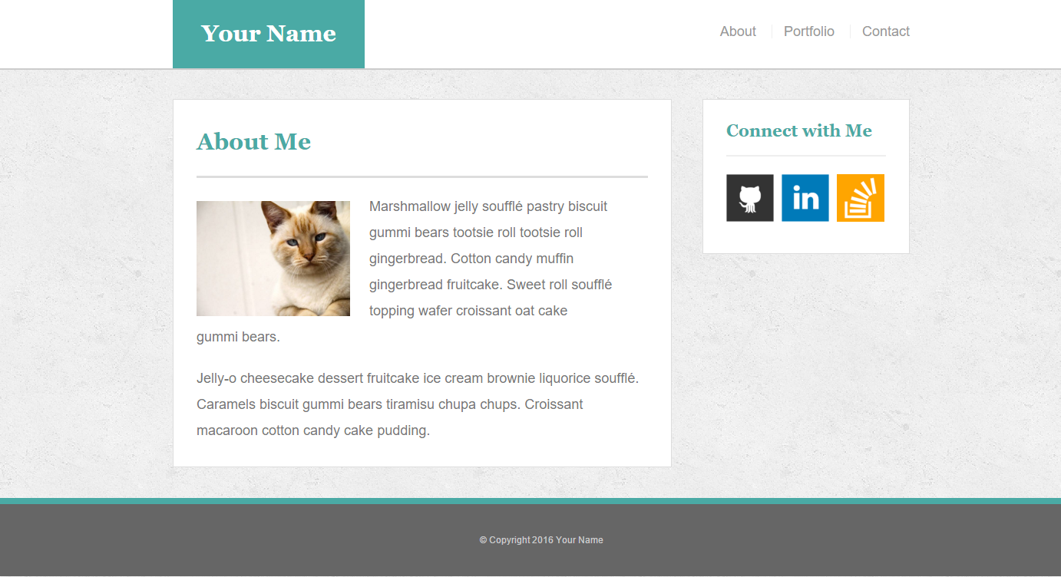
The Pains of HW 1
Plain HTML + CSS makes layout building challenging

Slide 10

But Then Came Bootstrap…
Notes:
10

Slide 11


Powered by Bootstrap
External CSS Link
Pre-Defined CSS Class (ex: “Jumbotron”)
Notes:
11

Slide 12
Powered by Bootstrap
class=“jumbotron”
Notes:
12

Slide 13

Big Deal!!!
Using Bootstrap,
we have PRE-DEFINED CSS Styles.
Notes:
13

Slide 14

Why Use Bootstrap?
Reason #1: UI Kit
Familiarize yourself with the UI features it offers via the documentation.
Once Bootstrap is active, you can simply copy snippets from the documentation to save yourself major time of creating elements yourself.
Notes:
14

Slide 15

Why Use Bootstrap?
Reason #2: Mobile Responsiveness
One of the most compelling reasons to use Bootstrap is the default mobile-responsive quality it provides.
This means that your website will look “good” automatically when viewed on screens ranging from monitors to tablets to phones.
Notes:
15

Slide 16
> YOUR TURN!!
Warmup Activity:
As a repeat of last class, quickly create an HTML web page.
Then add in a Bootstrap component of your choosing.
Hint: Copy the Bootstrap CSS link. Then copy the code from any Bootstrap element or CSS.

Slide 17
Next Phase Bootstrap
Last class, we focused on Bootstrap Components (like buttons and tables).
Today we’ll be focused on using Bootstrap to build layouts.
Notes:
17

Slide 18
Sketching / Grid Layouts
Notes:
18

Slide 19

Take a Huge Breath…

Slide 20
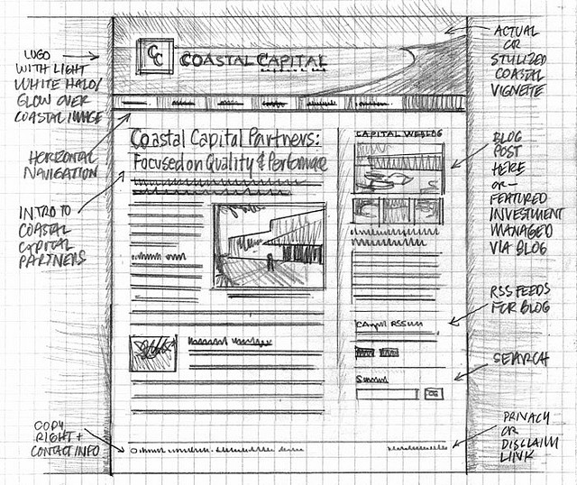
Importance of Sketches
Because every aspect of a site’s “look” is defined by HTML/CSS – it is crucial to have a detailed sketch going in.
Pay particular attention to the location of navigation bars, titles, headers, content, images, footers etc.
When imagining alignments, in particular, be mindful of the grid

Slide 21
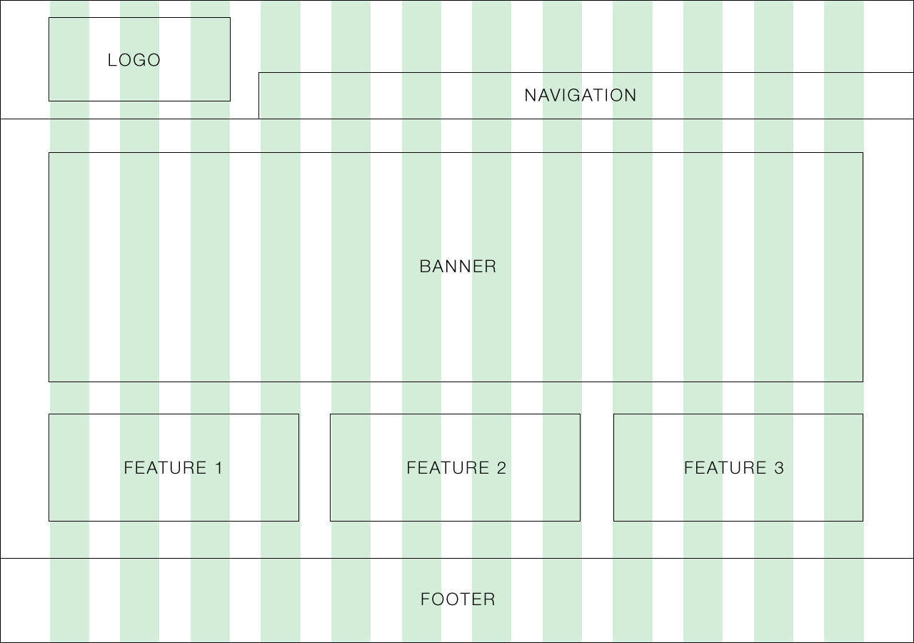
Designing with a Grid in Mind
Grids serve to align elements aesthetically.

Slide 22

Facebook’s Grid
Facebook is a perfect example of a website where the “grid-layout” is obvious.
Grids make it easy to have content (text, images, and regions) align aesthetically.

Slide 23
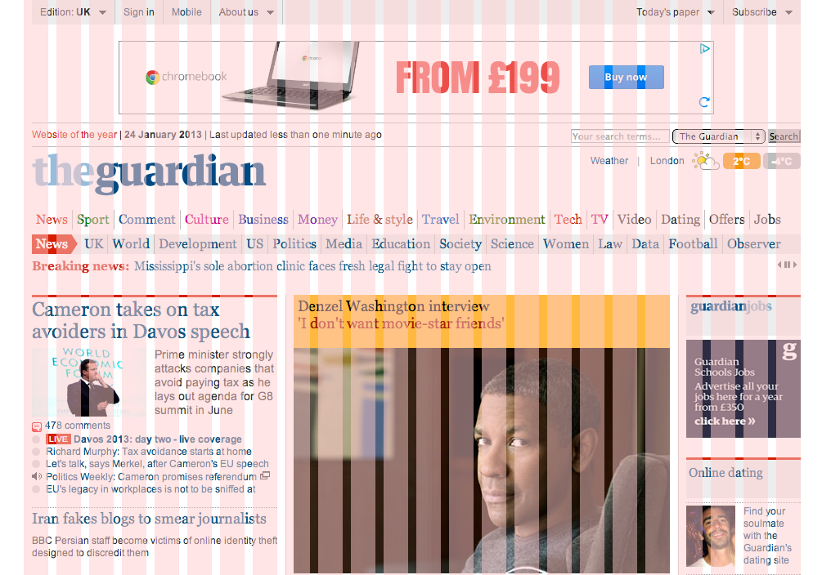
A More Complex Grid…

Slide 24
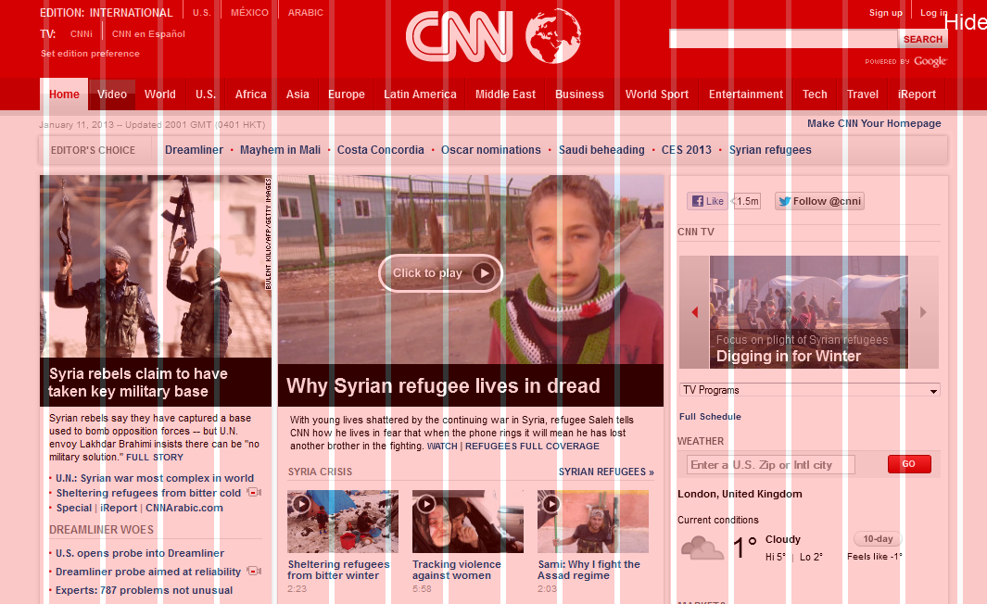
A More Complex Grid…

Slide 25
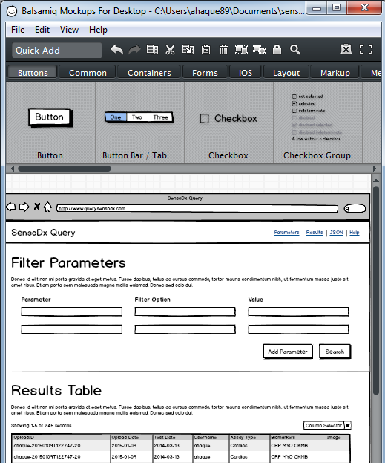
Tools for Sketch / Grid Creation
Wireframing Tools:
Balsamiq***: https://balsamiq.com/
Framebox: http://framebox.org/
Pen and Paper: Your notebook
Grids for Photoshop / Illustrator:
960 GS: http://960.gs/
GuideGuide: http://framebox.org/
Designing with Grids Guides:
960 Grid System Made Easy: http://bit.ly/1sjYaFC
Design by Grid: http://www.designbygrid.com/
Designing with Grid-Based Approach: http://bit.ly/1CM4Hzo

Slide 26
Rows and Columns
Workshop

Slide 27
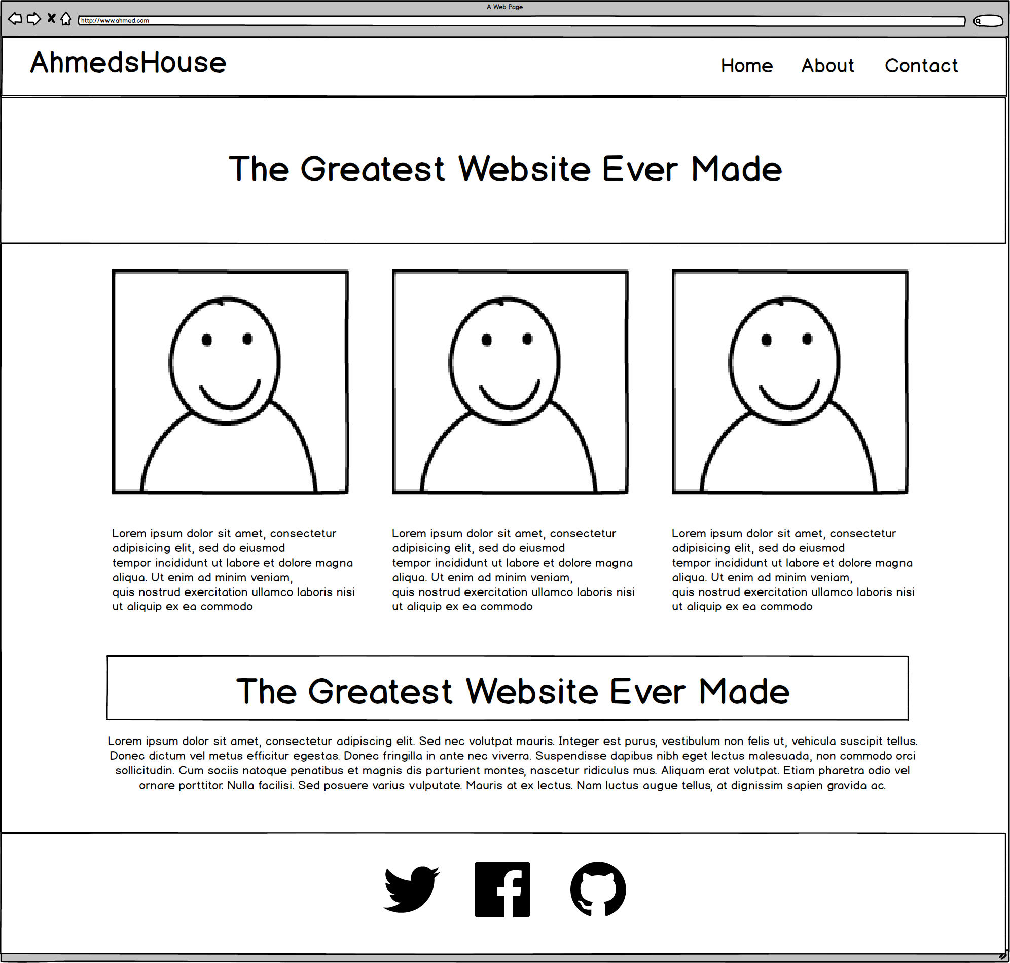
Web Design Fundamentally = Wireframes

Slide 28
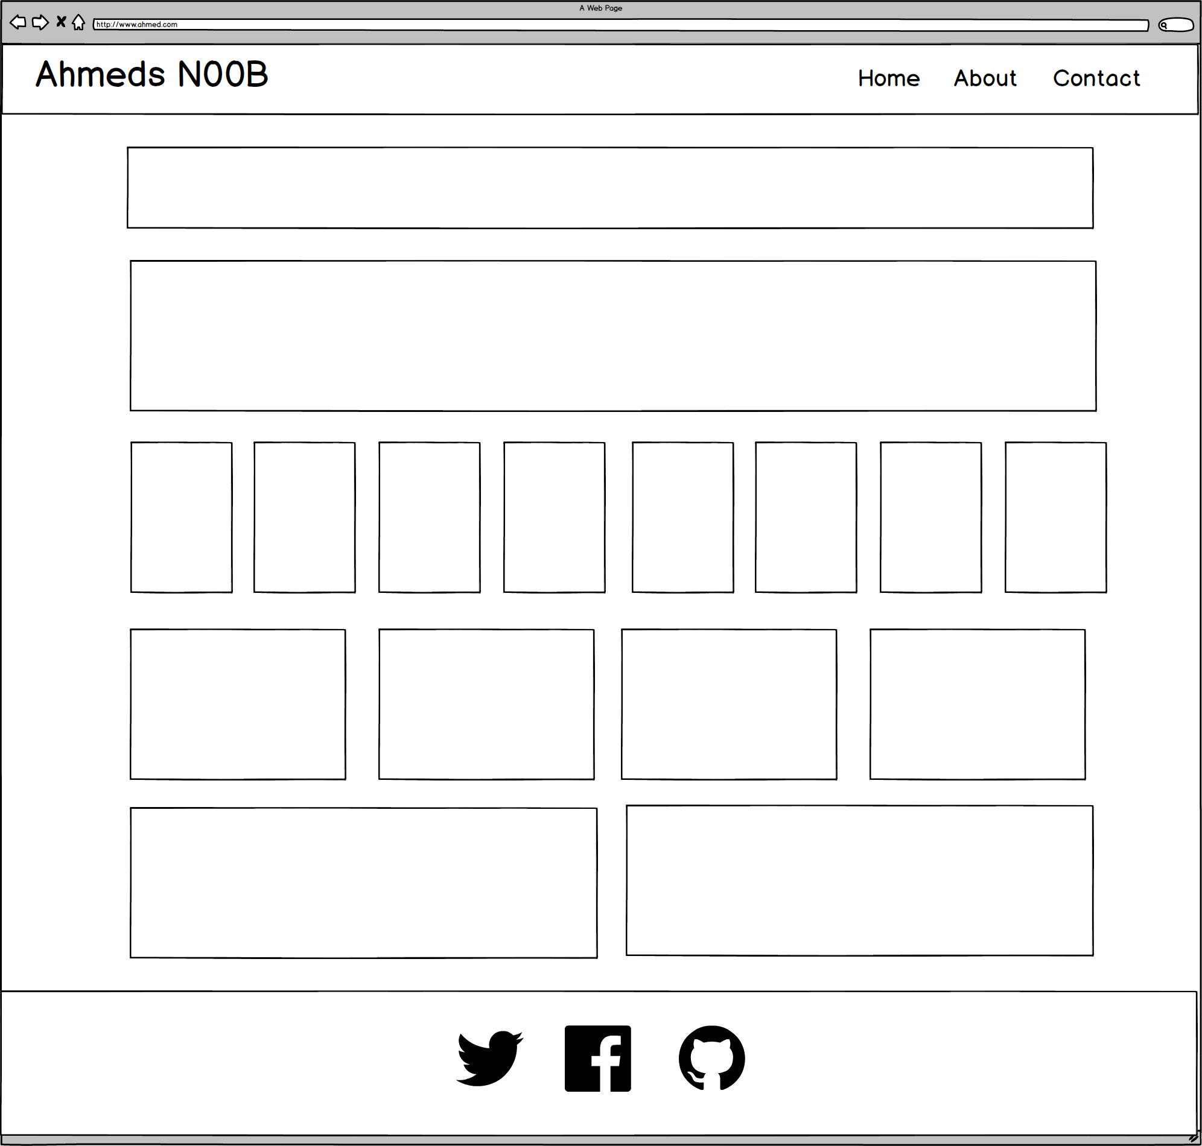
Notes:
7:00 – 7:05
28

Slide 29
ROWS
1
1
1
1
1
6 Total
1
Notes:
7:00 – 7:05
29

Slide 30
COLUMNS
1
1
8
4
2
1
Total Not relevant
Notes:
7:00 – 7:05
30

Slide 31
Level Up!
Now, let’s make it more challenging…

Slide 32
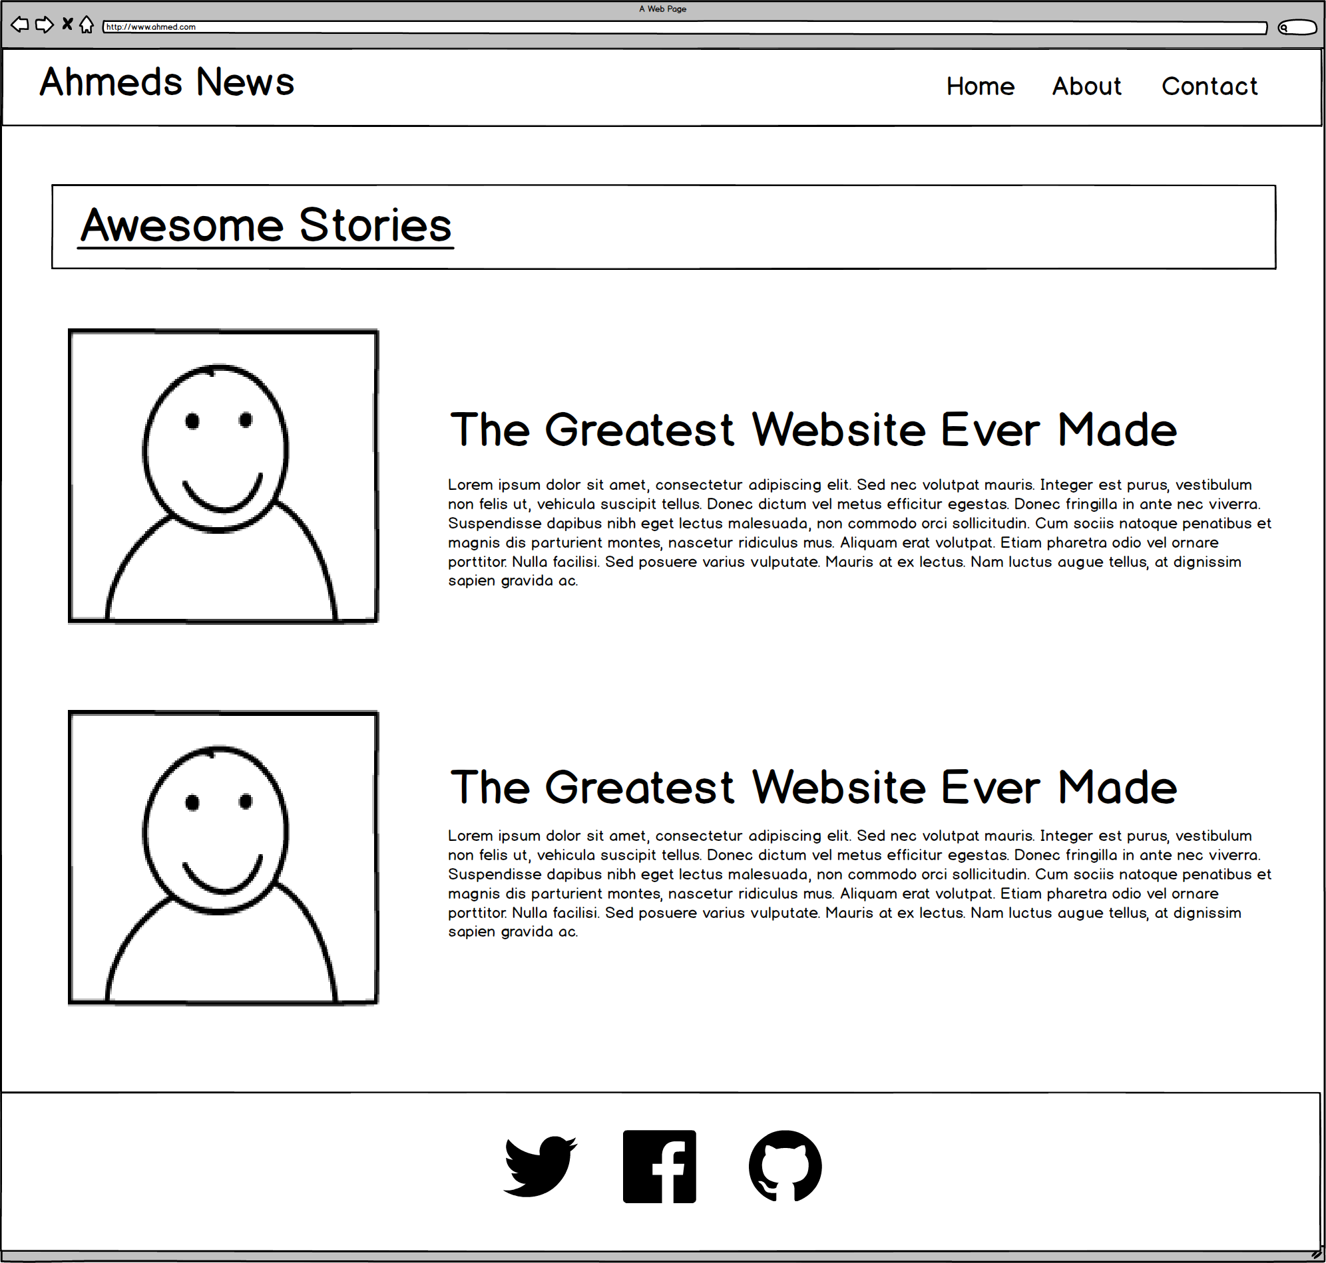
Notes:
7:00 – 7:05
32

Slide 33
ROWS
1
1
1
4
Total
1
Notes:
7:00 – 7:05
33

Slide 34
COLUMNS
1
2
2
1
Total Not relevant
Notes:
7:00 – 7:05
34

Slide 35
Level Up!
Now for another…

Slide 36
Notes:
7:00 – 7:05
36

Slide 37
ROWS
1
1***
1
4
Total
1
Notes:
7:00 – 7:05
37

Slide 38
COLUMNS
1
3
1
1
Total Not relevant
Notes:
7:00 – 7:05
38

Slide 39
Level Up!
This final one is tricky…

Slide 40

Notes:
7:00 – 7:05
40

Slide 41
Level Up!
Didn’t quite work right?
For this one we need sub-rows and sub-columns

Slide 42
ROWS
1
1***
1***
4
Total
1
Notes:
7:00 – 7:05
42

Slide 43
COLUMNS
1
2
1
Total Not relevant
Notes:
7:00 – 7:05
43

Slide 44
SUB-
ROWS
1
1
1
1
4
Total
Notes:
7:00 – 7:05
44

Slide 45
SUB-
COLUMNS
2
1
Notes:
7:00 – 7:05
45

Slide 46
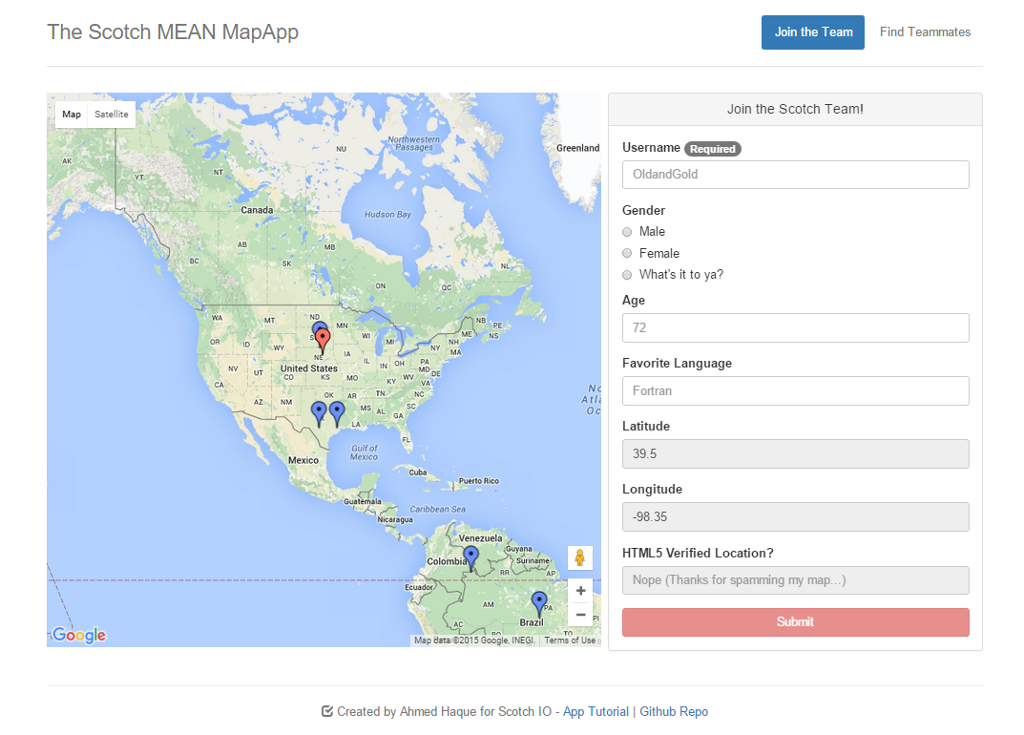
Notes:
7:00 – 7:05
46

Slide 47
ROWS
1
1
Notes:
7:00 – 7:05
47

Slide 48
COLUMNS
2
1
Notes:
7:00 – 7:05
48

Slide 49

Notes:
7:00 – 7:05
49

Slide 50
Grid Design with Bootstrap

Slide 52
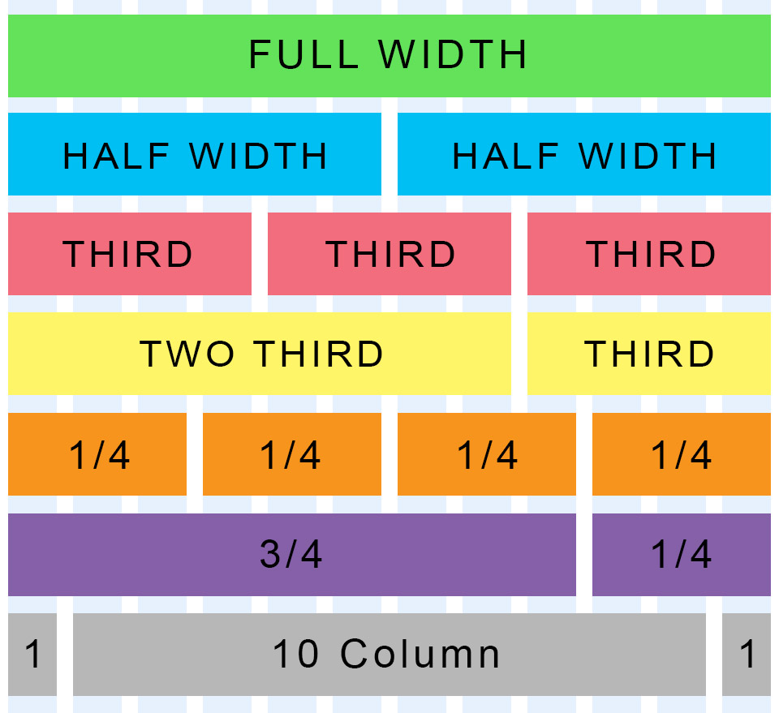
Bootstrap Grid
Bootstrap lets you organize content based on the “number of columns” a div spans – out of a total 12 columns.
Example:
<div class="col-md-12">
(Spans full width)
<div class="col-md-4">
(Spans 1/3 of full width)

Slide 53
Bootstrap Grids
Every Bootstrap Grids is made up of…
containers - which wrap around the entire grid)
rows - which are defined first and are just rows)
columns - which are defined within rows and specify the columns. The sum total of all columns within a row must add up to 12.
Each of these elements is implemented by creating a div with a specific class name.

Slide 54
Defining Columns
Container
Row #1
Column#1
Column#2
Column#3
Column#4

Slide 55

Bootstrap Grid
Note the rows, columns (col-lg-6), and containers

Slide 56
> YOUR TURN!!
Quick Activity:
Turn to your neighbors and explain to one another:
The relationship between containers, rows, and columns. (Draw it on a piece of paper for them)
2. The syntax for each.
3. The specific syntax details for columns.

Slide 57
Coding Grids

Slide 58
INSTRUCTOR DEMO!
Instructor: Demo
(quickgrid.html | 2-InstructorGrids)

Slide 59
Bootstrap Grid
Note the rows, columns (col-lg-6), and containers

Slide 60

Bootstrap Grid
Note the rows, columns (col-lg-6), and containers

Slide 61

Defining Containers
“Containers” are like the box that the entire grid sits inside.

Slide 62

Defining Rows
“Rows” are like the rows we talked about earlier.

Slide 63

Defining Columns
“Columns” fit inside of rows. Note the syntax: col-sz-#
Col = column
sz = viewing size (in this case: medium)
# = number of “columns taken” out of 12. (in this case 4 of 12)

Slide 64
> YOUR TURN!!
Activity:
Using Twitter bootstrap, create a layout that looks like the one shown on the next screen.
Spend some time prior to coding to draw out the grid layout
Count the number of rows and columns
Then use the bootstrap grid syntax to code it out.
Slack a screenshot of your page when you are done.
Ipsum Generator: http://www.lipsum.com/

Slide 65

> YOUR TURN!!

Slide 66
Building Bootstrap Layouts

Slide 67
INSTRUCTOR DEMO!
Instructor: Demo
(in-class-demo-layout.html | 15-InstructorLayout)

Slide 68
> YOUR TURN!!
Activity:
Working in pairs and using Twitter Bootstrap make the following design.
Be sure to note the:
Grid Layout
Navbar
Sidebar panel
Thumbnail
Additional details will be sent to you via slack.

Slide 69
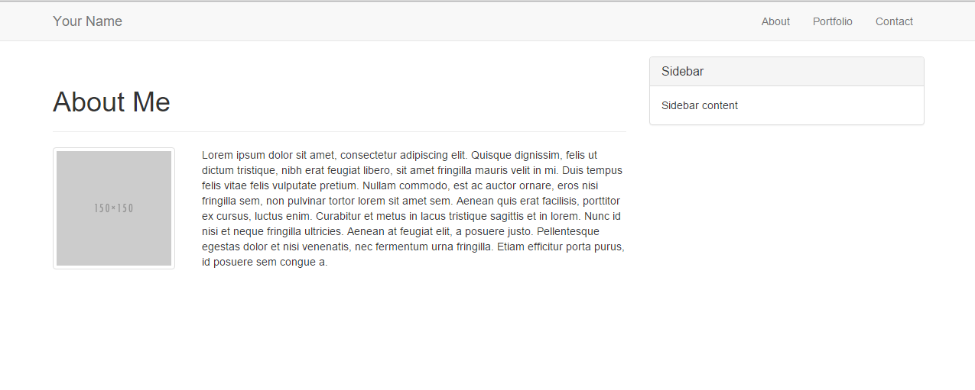
> YOUR TURN!!

Slide 70
Common Questions
Can I reverse the order (i.e. rows inside columns)? No. Columns always go inside of rows. Though, you can create sub-rows inside of columns. But those columns would still need to be inside of a row of their own.
Can I just avoid having a container? You could… But it will mess things up. Just throw in a container.
1. What if I have columns that go past 12? 2. Then your bootstrap grid will behave wildly. Don’t go past 12.
What if I don’t add up to 12? Nothing. You will have empty space at the end.

Slide 72
Mobile Responsive (HW)

Slide 73

Still No Facebook Time
Warning!
This next section matters a lot for your homework

Slide 74
Media Queries
Media Queries define how CSS styles are applied in relation to the characteristics of the viewing device.
Through media queries we can change the way a webpage is displayed based on width, height, orientation, and even resolution.
Bootstrap extensively uses media queries to help you create mobile responsive websites.
But remember! Media queries must be declared last.

Slide 75
INSTRUCTOR DEMO!
Instructor: Demo
(17-InstructorMedia)

Slide 76
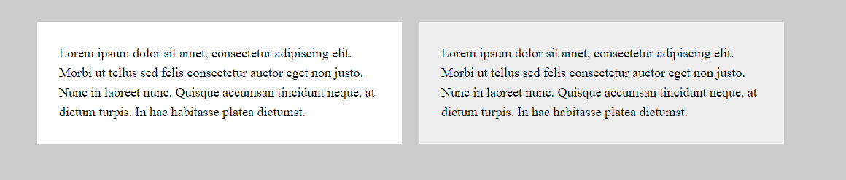
Quick Demo

Slide 77
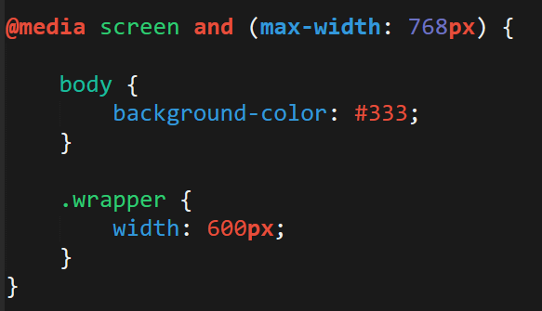
> YOUR TURN!!
Activity:
Explain to your partner what the following CSS code does:

Slide 78
> YOUR TURN!!
Activity:
Build your own mobile responsive HTML /CSS page using media queries.
Just follow the steps sent to you via Slack.

Slide 79
Viewport
Viewport is the user’s visible area of a web page.
Viewport controls how a web page is displayed on a mobile device. Without this, mobile devices would render the page at a typical desktop screen (scaled down).

Slide 80


Viewport
No Viewport
Yes Viewport

Slide 81
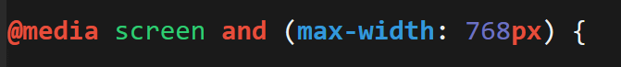
Viewport Inclusion
Just include this line in the head
And then include a variety of @media queries for various sized screens.

Slide 82
Questions?
Notes:
82

